Slide 1
ADAPTIVE DELTA MODULATION

Slide 2
ADM
Performance of a DM can be improved by making step size of modulator assume a time-varying form.

Slide 3
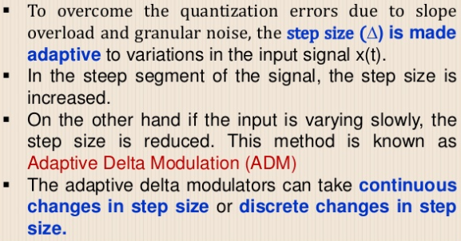

Slide 4
ADM
There are several types of ADM depending on type of scheme used for adjusting step size.
In one type, a discrete set of values is provided for step size.
In another type, a continuous range for step size variation is provided.

Slide 5
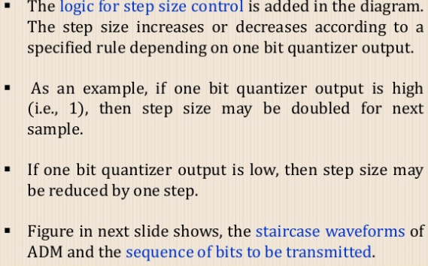
ADM TRANSMITTER

Slide 6
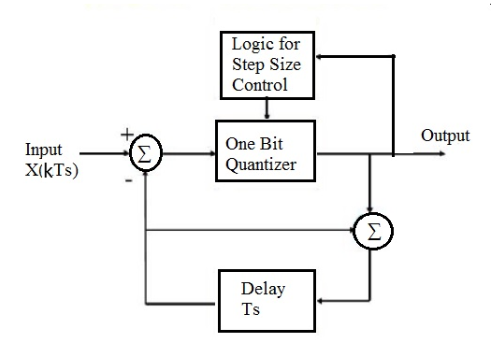
Block Diagram of ADM

Slide 7
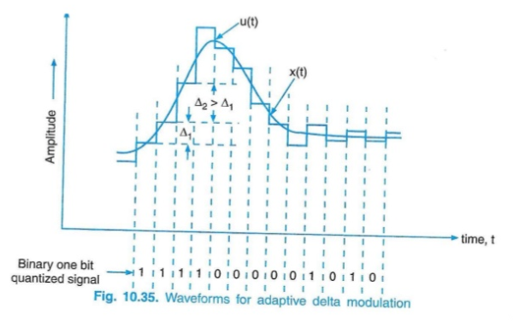

Slide 8
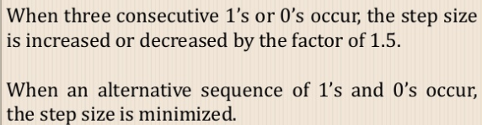
COMMON ALGORITHM

Slide 9
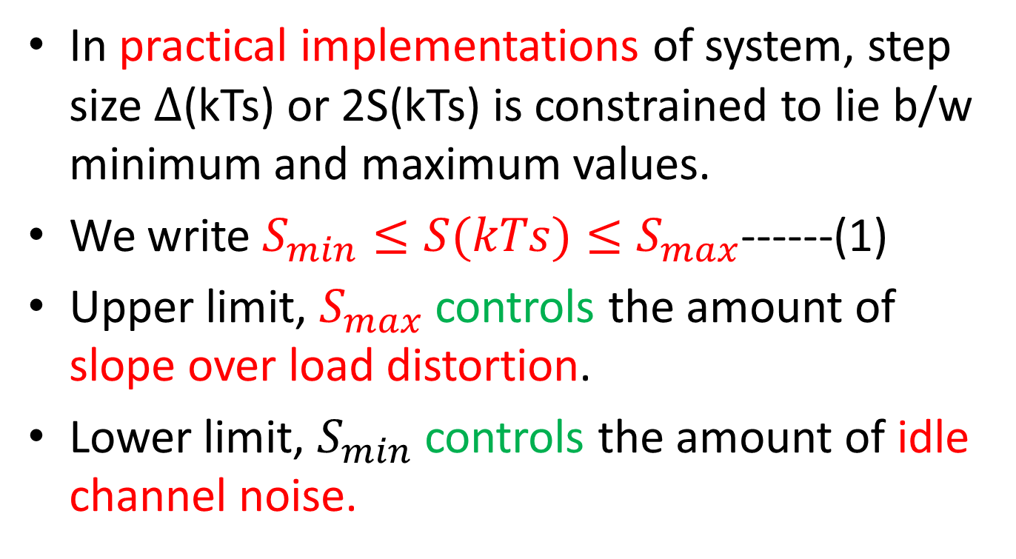
ADM
In practical implementations of system, step size $∆$(kTs) or 2S(kTs) is constrained to lie b/w minimum and maximum values.
We write $S_{min}≤S(kTs)≤S_{max}$------(1)
Upper limit, $S_{max}$ controls the amount of slope over load distortion.
Lower limit, $S_{min}$ controls the amount of idle channel noise.

Slide 10
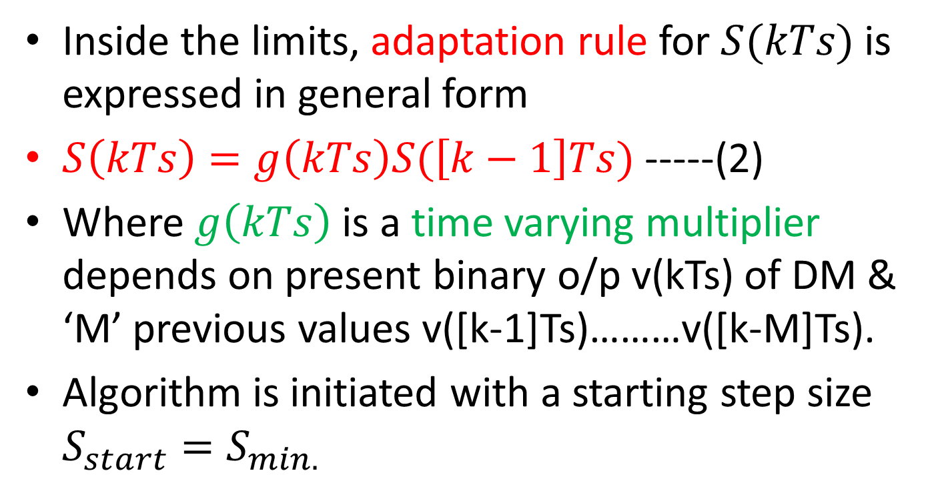
ADM
Inside the limits, adaptation rule for $S(kTs)$ is expressed in general form
$S\left(kTs\right)=g\left(kTs\right)S(\left[k−1\right]Ts)$ -----(2)
Where $g\left(kTs\right)$ is a time varying multiplier depends on present binary o/p v(kTs) of DM & ‘M’ previous values v([k-1]Ts)………v([k-M]Ts).
Algorithm is initiated with a starting step size $S_{start}=S_{min.}$

Slide 11

ADM
A simple version of the formula in equation (2) involves use of v(kTs) and v([k-1]Ts) only , given by
$g\left(kTs\right)=\left\{\begin{aligned}K, if v\left(kTs\right)=v(\left[k−1\right)Ts) \\ &K^{−1}, if v\left(kTs\right)≠v\left(\left[k−1\right]Ts\right) −−−(3) \end{aligned}\right.$

Slide 12
ADM
This adaptation algorithm is called a constant factor ADM with “one-bit memory”.
The term “one-bit memory” refers to explicit utilization of single previous bit v([k-1]Ts).
Algorithm of equation (3) with K=1.5, has been found to be well-matched
to typical speech and image i/ps alike, for a wide range of bit rates.

Slide 13
ADM
At bit rates of 20 to 60 kb/s, use of algorithm for speech coding realizes gains in SNR equal to 5 to 10 dB
over optimum LDM for which constant K=1.
k

Slide 14
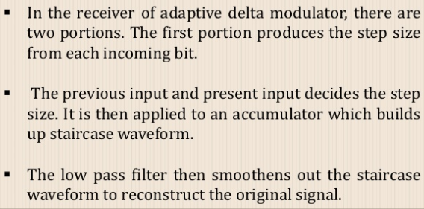
ADM RECEIVER

Slide 15
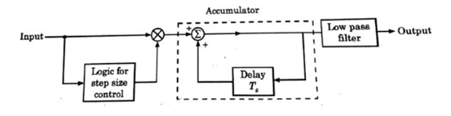
Block Diagram of ADM

Slide 16
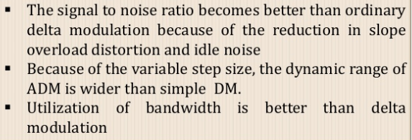
ADVANTAGES OF ADM

Slide 17
Coding speech at low bit rates
Use of PCM at standard rate of 64kb/s demands a high channel bandwidth for its transmission.
In certain applications where channel bandwidth is at a premium,
Need speech coding at low bit rates,
While maintaining acceptable fidelity or quality of reproduction.

Slide 18
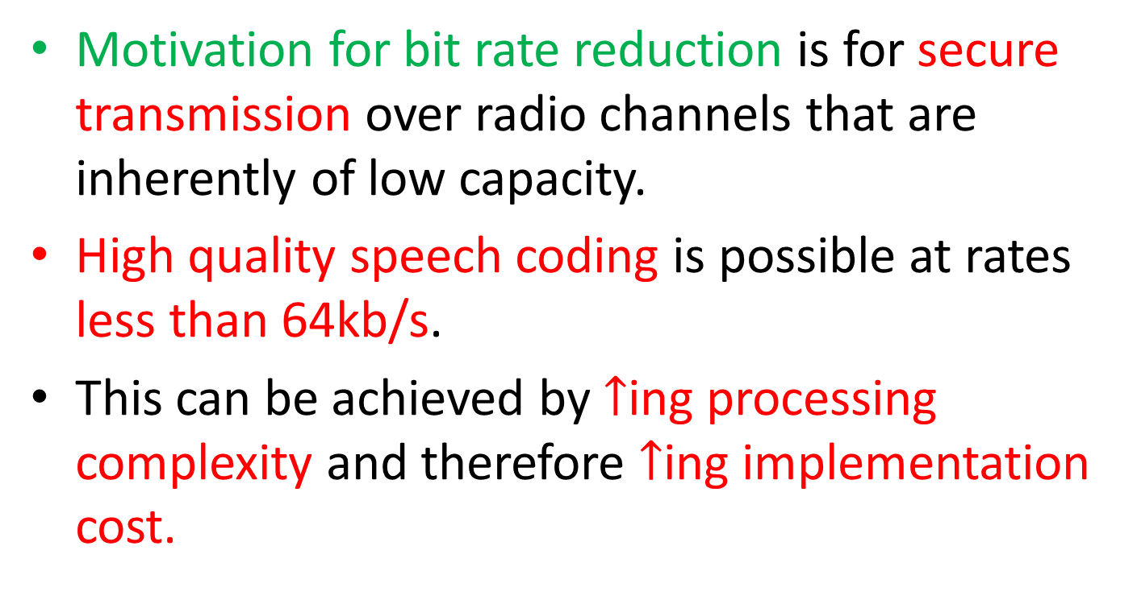
Cont..
Motivation for bit rate reduction is for secure transmission over radio channels that are inherently of low capacity.
High quality speech coding is possible at rates less than 64kb/s.
This can be achieved by $↑$ing processing complexity and therefore $↑$ing implementation cost.

Slide 19
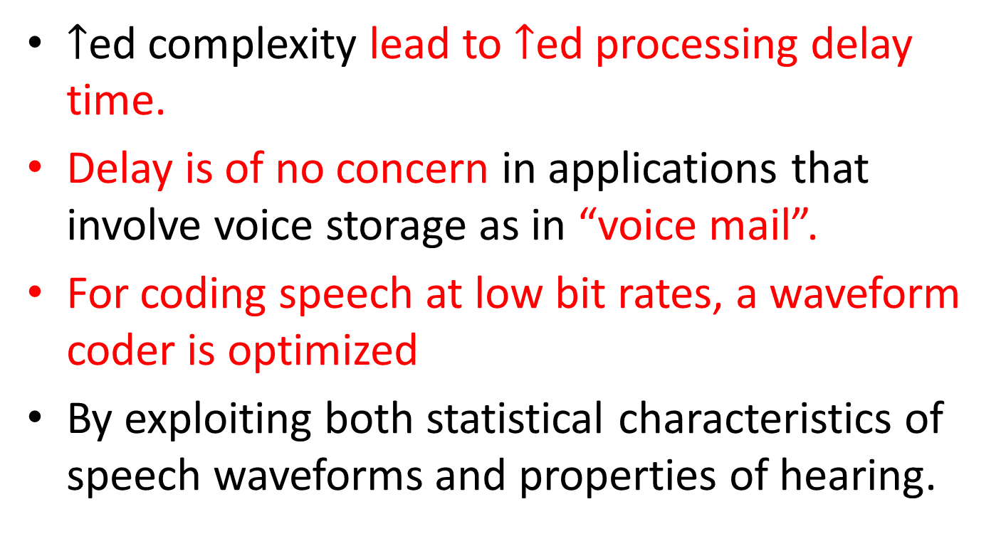
Cont…
$↑$ed complexity lead to $↑$ed processing delay time.
Delay is of no concern in applications that involve voice storage as in “voice mail”.
For coding speech at low bit rates, a waveform coder is optimized
By exploiting both statistical characteristics of speech waveforms and properties of hearing.

Slide 20
Cont…
A design has 2 aims:
(1) to remove redundancies from speech signal as far as possible.
(2) to assign available bits to code non redundant parts of speech signal in efficient manner.
As we try to reduce bit rate from 64kb/s to 32,16,8 & 4 kb/s

Slide 21
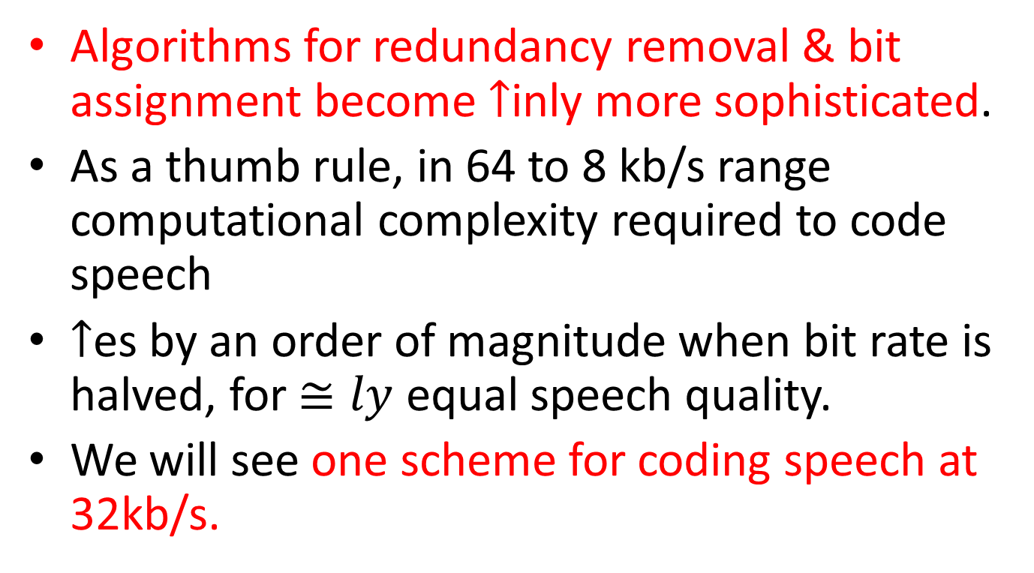
Cont…
Algorithms for redundancy removal & bit assignment become $↑$inly more sophisticated.
As a thumb rule, in 64 to 8 kb/s range computational complexity required to code speech
$↑$es by an order of magnitude when bit rate is halved, for $≅ly$ equal speech quality.
We will see one scheme for coding speech at 32kb/s.

Slide 22
ADAPTIVE DIFFERENTIAL PULSE CODE MODULATION

Slide 23
ADAPTIVE DPCM
Reduction in number of bits per sample from 8 (as in std. PCM) to 4 involves
Combined use of adaptive quantization and adaptive prediction.
Term “adaptive” means being responsive to changing level & spectrum of i/p speech signal.
Why we go for adaptive quantization & adaptive prediction?

Slide 24
ADPCM
Variation of performance with speakers & speech material,
Together with variations in signal level in speech communication process needs
Combined use of AQ and AP
To achieve best performance over a wide range of speakers & speaking situations.
A digital coding scheme that uses both AQ & AP is called Adaptive Differential PCM (ADPCM).

Slide 25
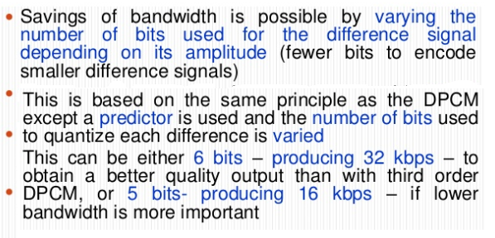
ADPCM

Slide 26
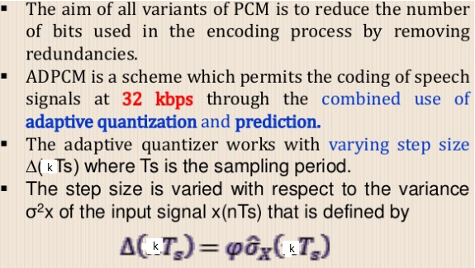
NEED FOR ADPCM

Slide 27
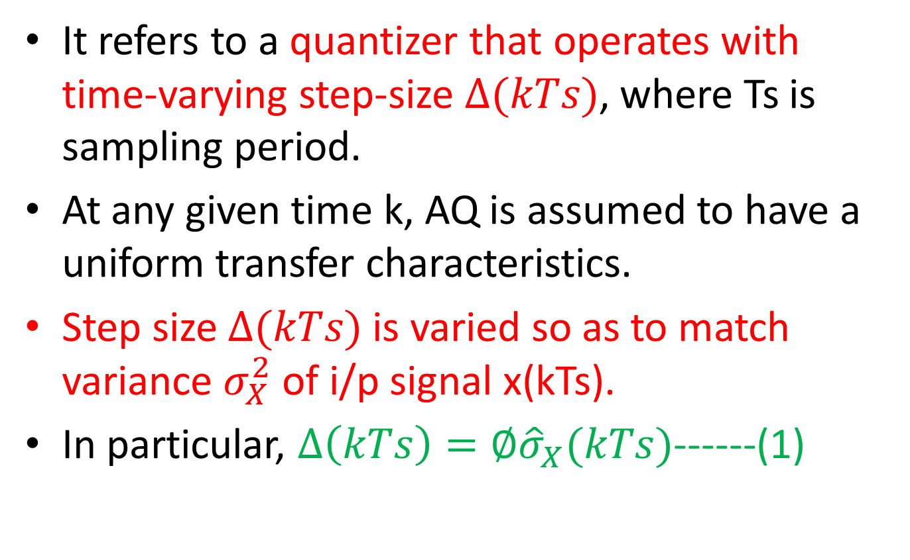
Adaptive Quantization
It refers to a quantizer that operates with time-varying step-size $∆(kTs)$, where Ts is sampling period.
At any given time k, AQ is assumed to have a uniform transfer characteristics.
Step size $∆(kTs)$ is varied so as to match variance $σ_{X}^{2}$ of i/p signal x(kTs).
In particular, $∆\left(kTs\right)=∅{\hat{σ}}_{X}(kTs)$------(1)

Slide 28
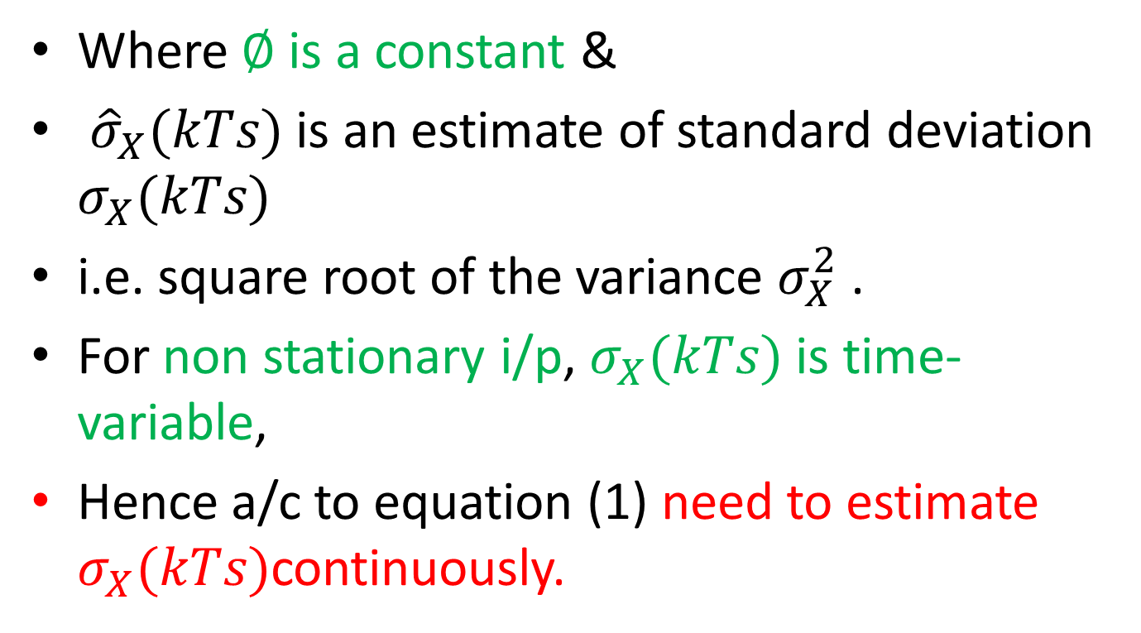
Cont…
Where $∅$ is a constant &
${\hat{σ}}_{X}(kTs)$ is an estimate of standard deviation $σ_{X}(kTs)$
i.e. square root of the variance $σ_{X}^{2}$ .
For non stationary i/p, $σ_{X}(kTs)$ is time-variable,
Hence a/c to equation (1) need to estimate $σ_{X}(kTs)$continuously.

Slide 29
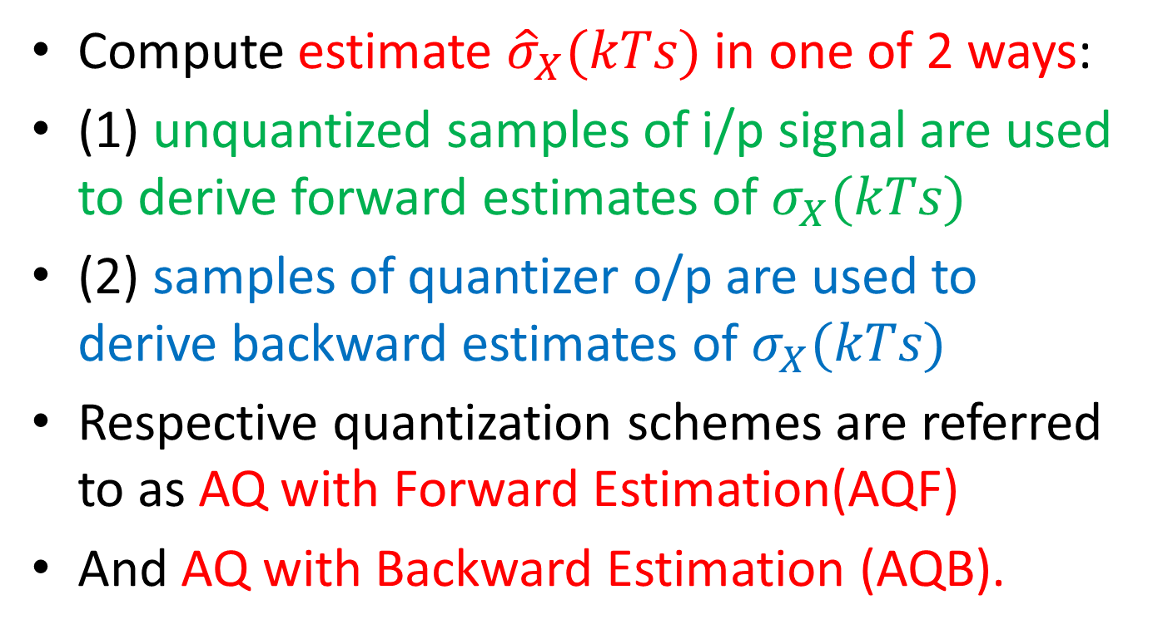
Cont…
Compute estimate ${\hat{σ}}_{X}(kTs)$ in one of 2 ways:
(1) unquantized samples of i/p signal are used to derive forward estimates of $σ_{X}(kTs)$
(2) samples of quantizer o/p are used to derive backward estimates of $σ_{X}(kTs)$
Respective quantization schemes are referred to as AQ with Forward Estimation(AQF)
And AQ with Backward Estimation (AQB).

Slide 30
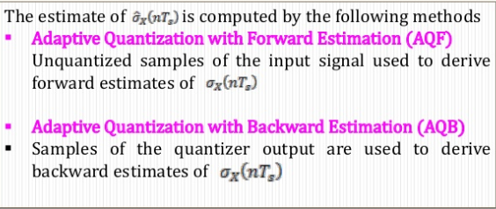
AQ

Slide 31
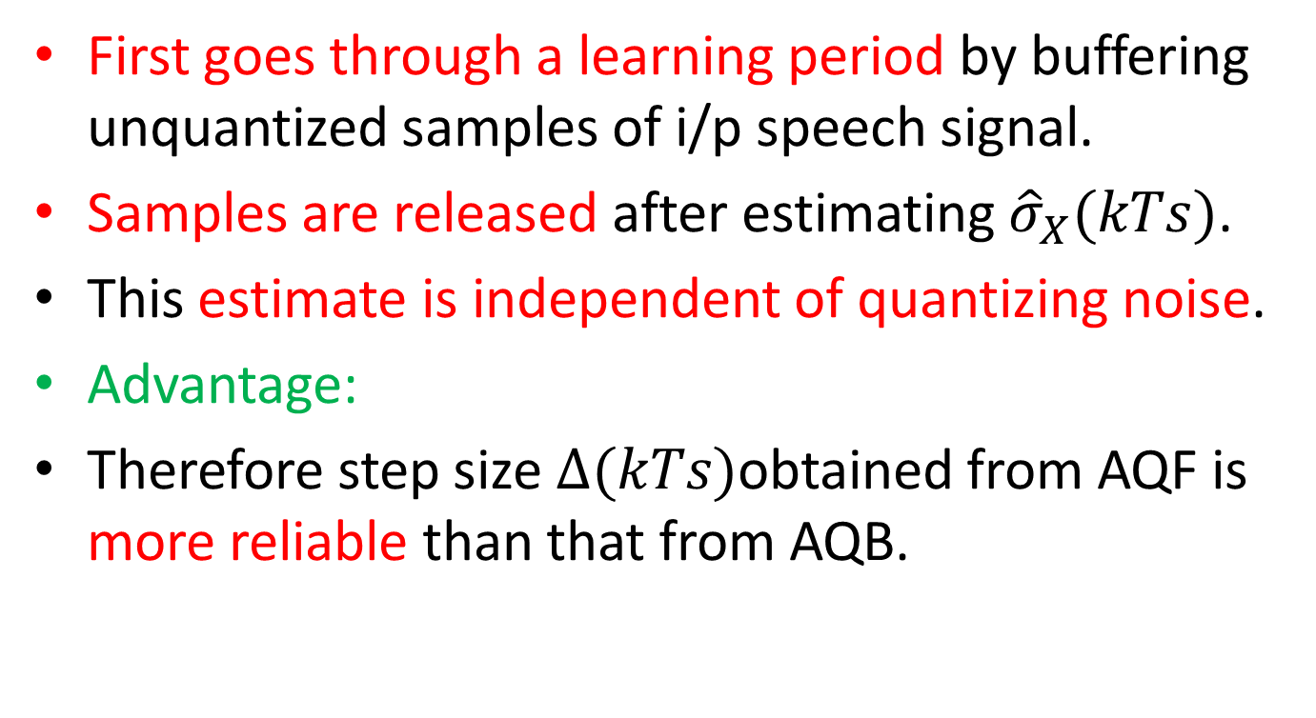
AQF
First goes through a learning period by buffering unquantized samples of i/p speech signal.
Samples are released after estimating ${\hat{σ}}_{X}(kTs)$.
This estimate is independent of quantizing noise.
Advantage:
Therefore step size $∆(kTs)$obtained from AQF is more reliable than that from AQB.

Slide 32
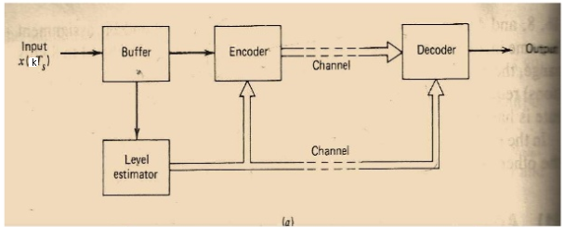
AQ with Forward Estimation

Slide 33
AQF
Demerits:
Requires explicit transmission of level information (about 5 to 6 bits per step size sample) to a remote decoder.
Burdening s/m with additional side information to be transmitted to receiver.
Also, a processing delay (16ms) in encoding operation .

Slide 34
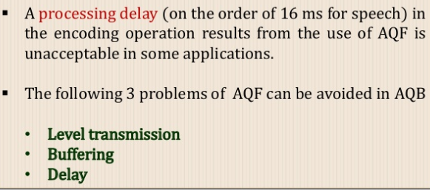
AQF

Slide 35
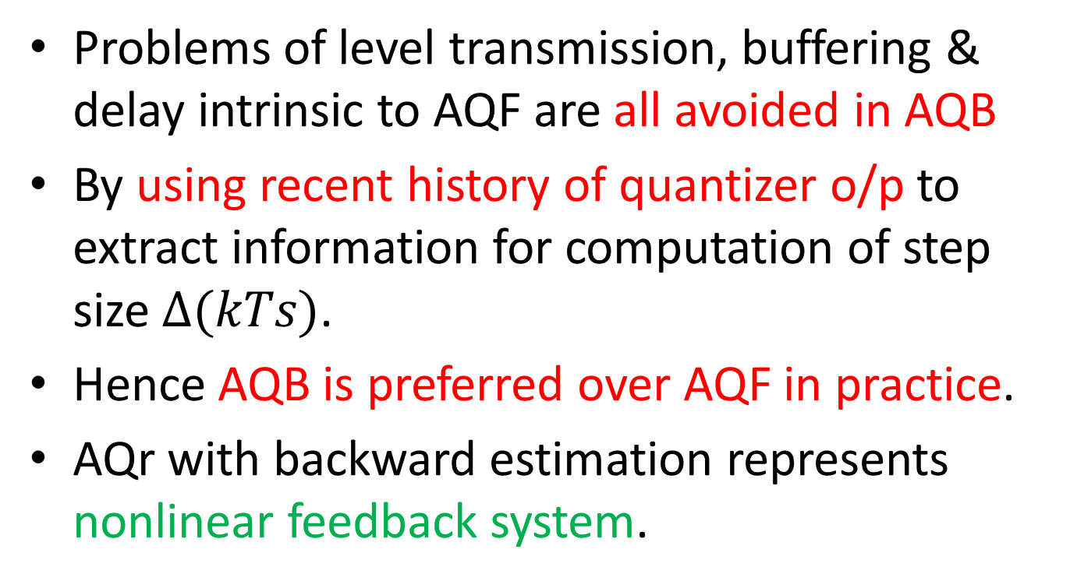
AQB
Problems of level transmission, buffering & delay intrinsic to AQF are all avoided in AQB
By using recent history of quantizer o/p to extract information for computation of step size $∆(kTs)$.
Hence AQB is preferred over AQF in practice.
AQr with backward estimation represents nonlinear feedback system.

Slide 36
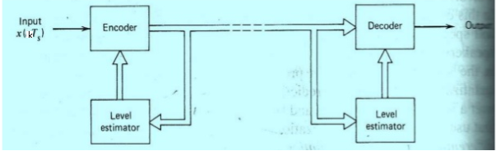
AQ with Backward Estimation

Slide 37

AQB
s/m will be stable if quantizer i/p $x(kTs)$ is bounded,
Then so are the backward estimate ${\hat{σ}}_{X}(kTs)$ & corresponding step size $∆(kTs)$.

Slide 38
APn
Because speech signals are non stationary, use of APn is justified.
Its autocorrelation function and PSD are time-varying functions of their respective variables.
This implies that design of predictors for such i/ps should be time-varying, i.e. adaptive.
There are 2 schemes for performing Apn:

Slide 39
APn
(1) APn with forward estimation (APF), in which unquantized samples of i/p signal are used to derive estimates of predictor coefficients.
(2) Apn with backward estimation(APB), in which samples of quantizer o/p & prediction error are used to derive estimates of predictor coefficients.

Slide 40
APF
In APF scheme, N quantized samples of input speech are 1st buffered &
Then released after computation of ‘M’ predictor coefficients that are optimized for buffered segment of i/p samples.
Choice of ‘M’ involves a compromise b/w an AP gain & an acceptable amount of side information.

Slide 41
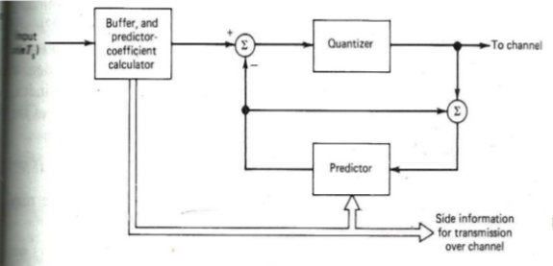
APn with forward estimation

Slide 42
APF
Similarly, choice of learning period or buffer length ’N’ involves a compromise b/w
Rate at which statistics of i/p speech signal change &
rate at which information on predictor coefficients must be updated & transmitted to receiver.

Slide 43
APF
For speech signal, a good choice of “N” corresponds to 16ms buffer for a sampling rate of 8KHz.
Choice of M=10 ensures adequate use of short-term predictability of speech.
Demerits:
APF suffers from same disadvantages-side information, buffering & delay as in AQF.

Slide 44
APB
These disadvantages are eliminated by using APB scheme.
Optimum predictor coefficients are estimated on basis of quantized & transmitted data,
They can be updated as frequently as desired
For example from sample to sample.
a/cly APB is preferred method of prediction.
Block named “logic for APn” is used to represent mechanism for updating predictor coefficients.

Slide 45
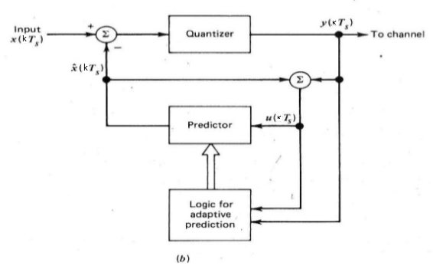
APn with back estimation

Slide 46
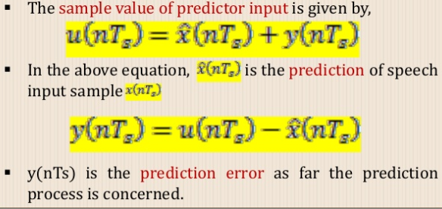
APB

Slide 48
TIME DIVISION MULTIPLEXING

Slide 49
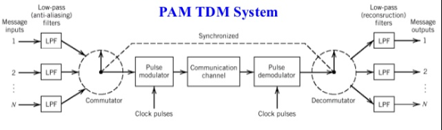
TDM

Slide 50
TDM
Sampling theorem provides basis for transmitting information contained in a band-limited message signal m(t)
As a sequence of samples of m(t) taken uniformly at a rate that is slightly higher than Nqyuist rate.
Important feature of sampling process is a conservation of time.

Slide 51
Cont..
i.e. transmission of message samples uses the communication channel for only a fraction of sampling interval on a periodic basis.
In this way some of the time interval b/w adjacent samples is cleared for use by other independent message sources on a time-shared basis.
Therefore TDM s/m is obtained.

Slide 52
TDM
It enables joint utilization of a common communication channel by a plurality of independent message sources without mutual interference among them.

Slide 53
LPF
Each i/p message signal is first restricted in bandwidth by low-pass anti-aliasing filter
to remove the frequencies that are nonessential to an adequate signal representation.
o/p of LPF are then applied to a commutator
Which is implemented using electronic switching circuitry.

Slide 54
Commutator
To take a narrow sample of each of ‘N’ i/p messages at a rate fs that is slightly higher than 2W.
Where W is cutoff frequency of anti-aliasing filter.
To sequentially interleave these ‘N’ samples inside a sampling interval Ts=1/fs

Slide 55
Cont…
Then multiplexed signal is applied to a pulse-amplitude modulator
It transforms multiplexed signal into a form suitable for transmission over communication channel.
Suppose that ‘N’ message signals to be multiplexed have similar spectral properties.
Then sampling rate for each message signal is determined in a/c with sampling theorem.

Slide 56
Cont…
Let Ts denote sampling period so determined for each message signal.
Let Tx denote time spacing b/w adjacent samples in time-multiplexed signal.
Set Tx=Ts/N
It introduces a bandwidth expansion factor ‘N’.
Because it must squeeze’N’ samples derived from N independent message signals into a time slot equal to one sampling interval.

Slide 57
Receiver
Received signal is applied to a PA demodulator
Which performs reverse operation of PAMr.
Short pulses produced at pulse demodulator o/p are distribute to appropriate LP reconstruction filters
By means of a decommutator,
It operates in synchronism with commutator in transmitter.

